Slide 1
Human Vision and Computer Vision

Slide 2
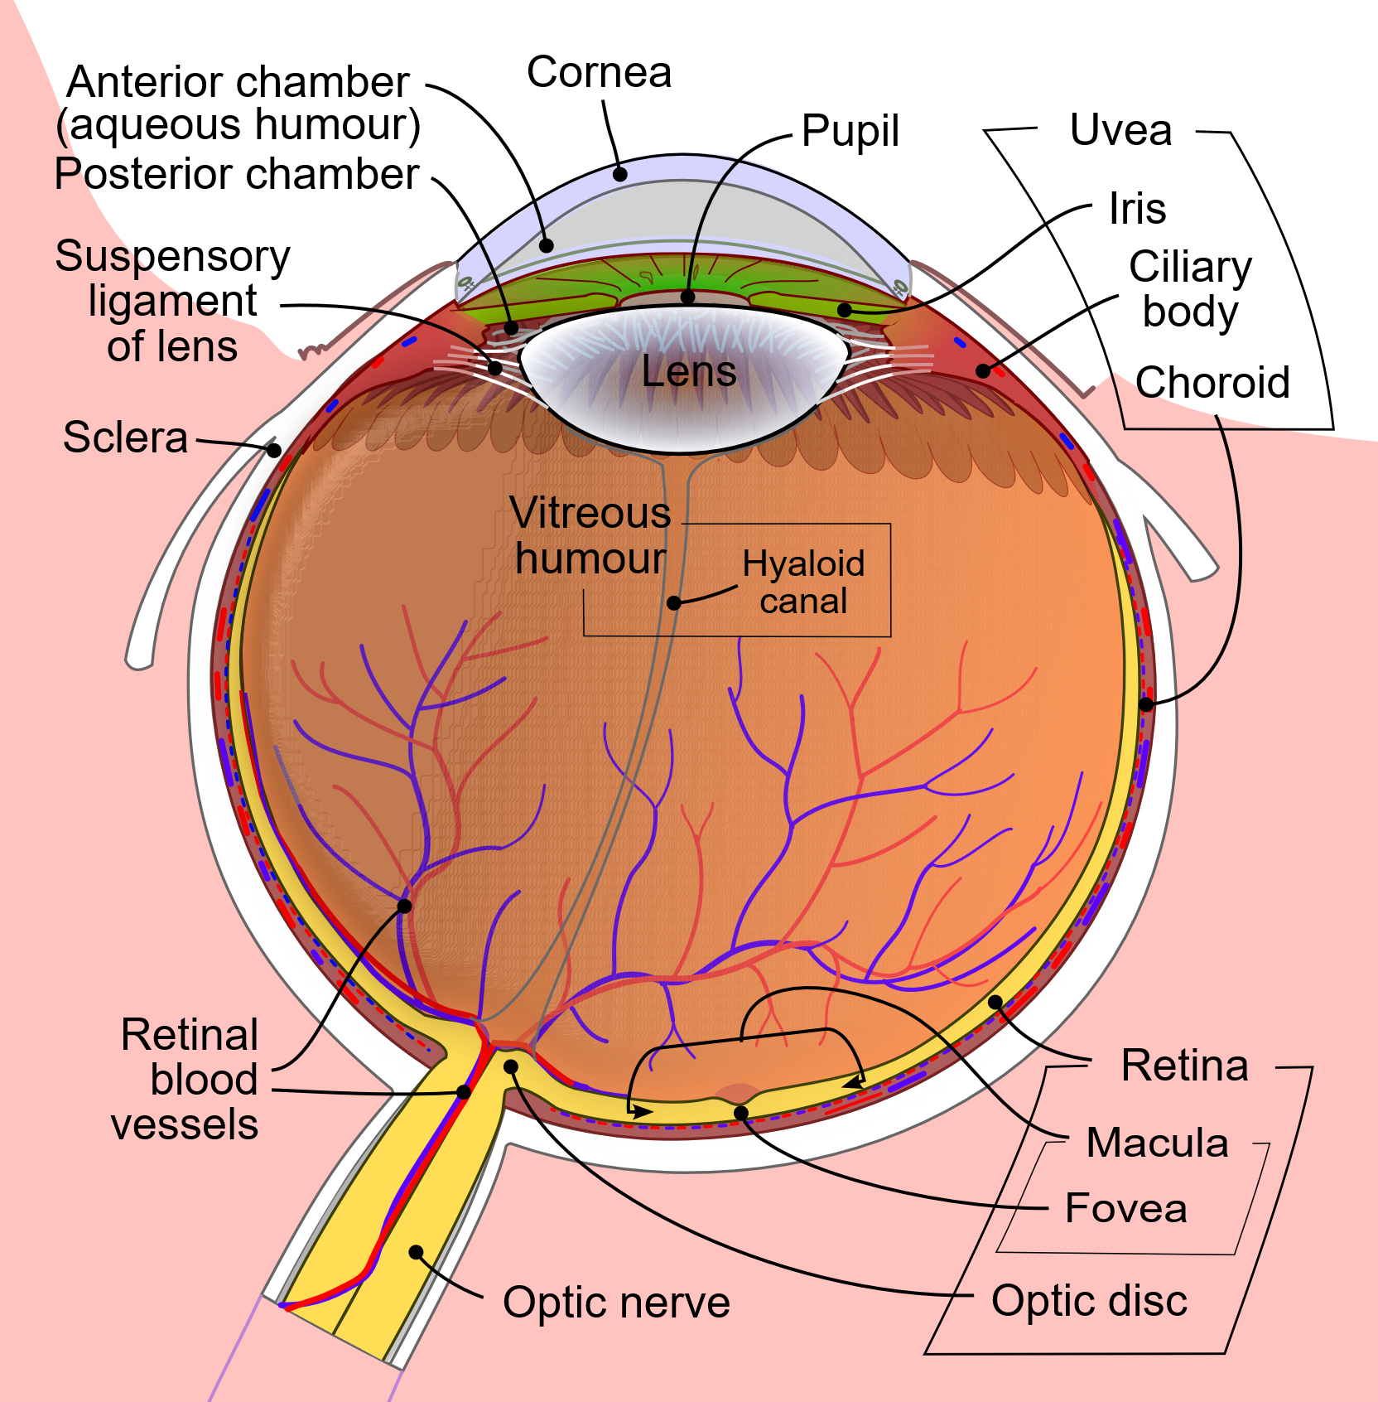
Hardware: The Eye
Cornea/lens focus; pupil controls light
Fovea = high acuity & color
Periphery = motion & low light
Blind spot where optic nerve exits
By Rhcastilhos. And Jmarchn. - Schematic_diagram_of_the_human_eye_with_English_annotations.svg, CC BY-SA 3.0, https://commons.wikimedia.org/w/index.php?curid=1597930
Notes:
Resolution isn’t uniform. We have a high-resolution ‘spotlight’ (fovea) and coarse periphery. We constantly move our eyes to stitch a detailed scene. This ‘foveation’ is a key design choice of biology.

Slide 3
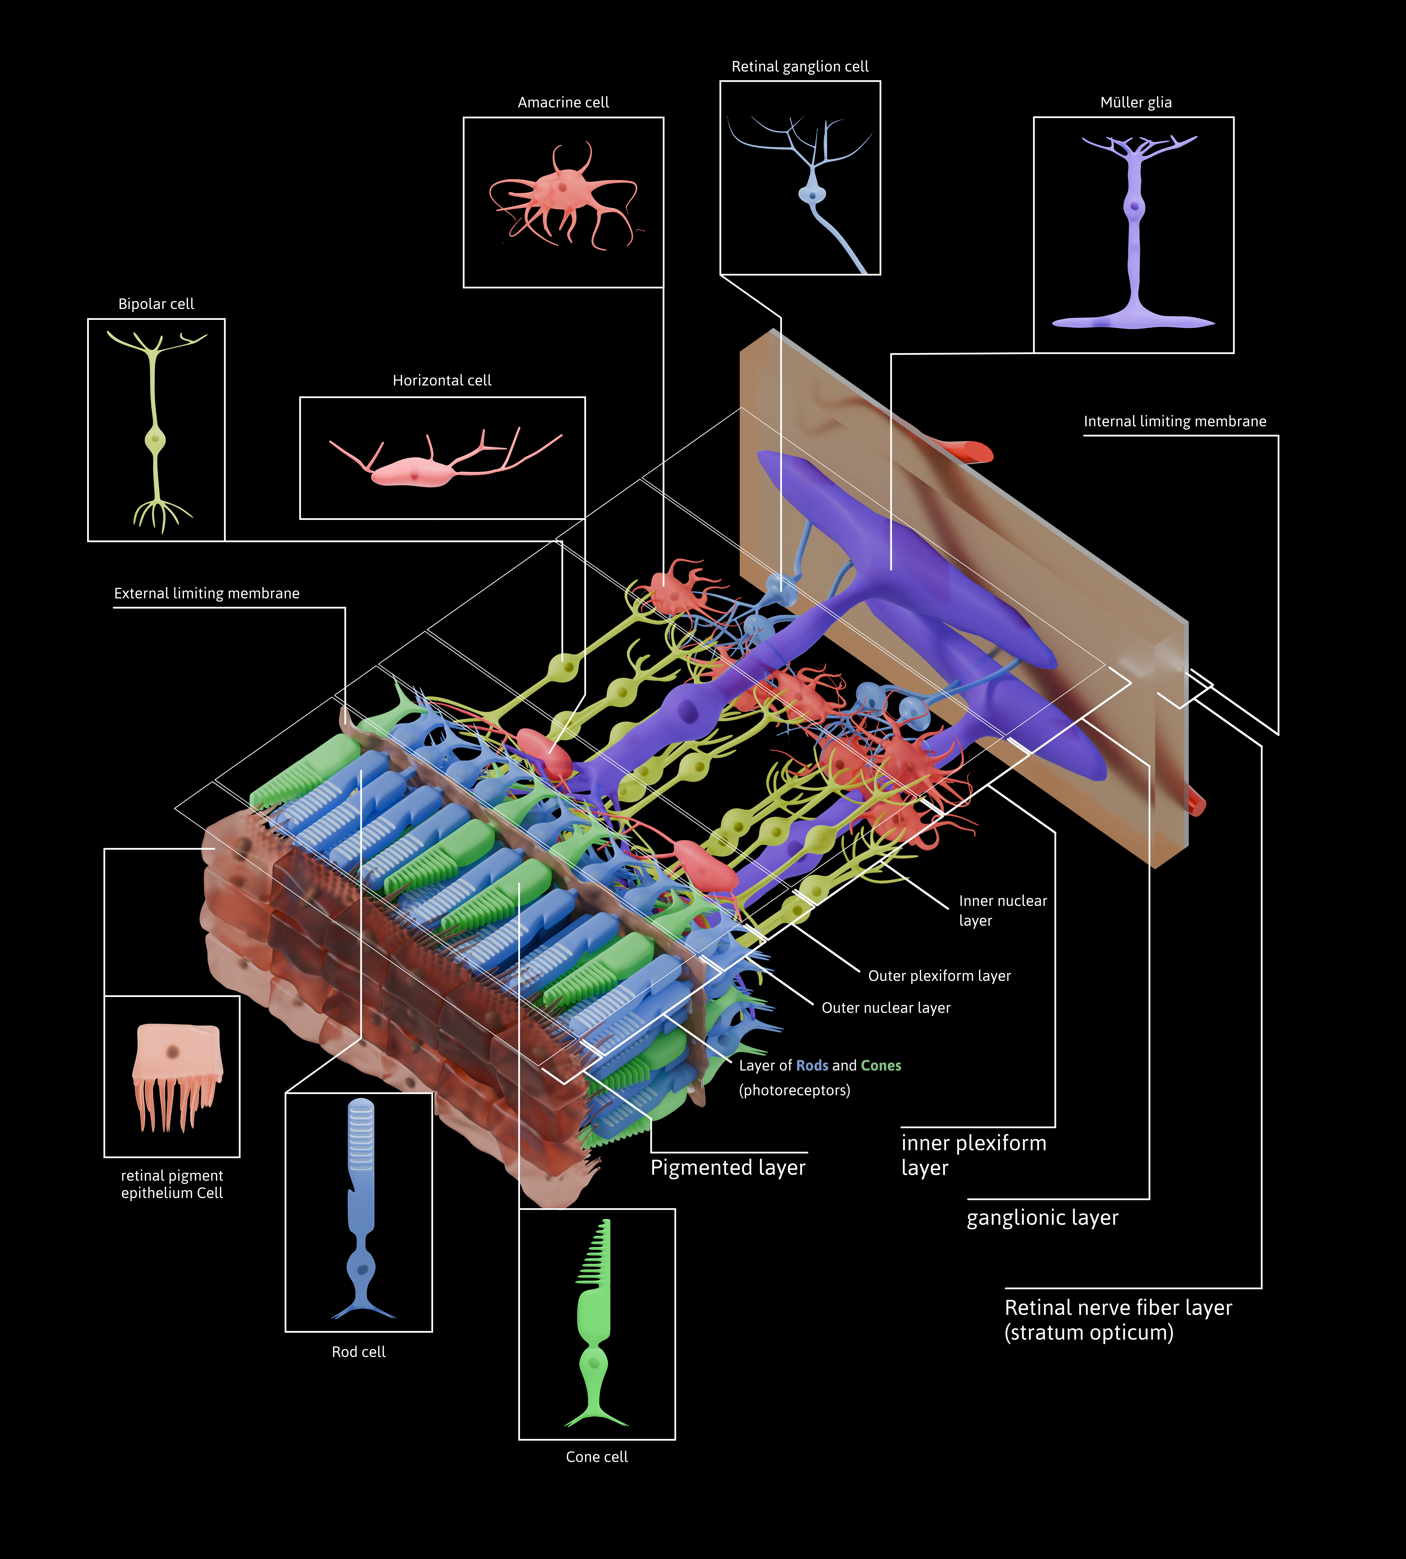
Pre-Processing: The Retina
[ Image placeholder: Center–surround kernel sketch + rod/cone distribution across retina ]
Convert light to neural signals and pre-process the image before it ever reaches the brain (contrast, edges, temporal changes).
By Otosakanum2 - Own work, CC BY-SA 4.0, https://commons.wikimedia.org/w/index.php?curid=174602486
Notes:
Before the brain sees anything, the retina extracts contrasts and edges. Ganglion cells respond to differences, not absolute brightness. That’s why edges and changes pop out—and why many illusions target contrast assumptions.

Slide 4
The Retina: Key Cell Types
[ Image placeholder: Center–surround kernel sketch + rod/cone distribution across retina ]
Photoreceptors:
Rods
Very light-sensitive
No color
Dominate the periphery
Night vision
Cones
Color
Fine detail
Daylight vision
By Otosakanum2 - Own work, CC BY-SA 4.0, https://commons.wikimedia.org/w/index.php?curid=174602486
Notes:
Before the brain sees anything, the retina extracts contrasts and edges. Ganglion cells respond to differences, not absolute brightness. That’s why edges and changes pop out—and why many illusions target contrast assumptions.

Slide 5
The Retina: Key Cell Types
[ Image placeholder: Center–surround kernel sketch + rod/cone distribution across retina ]
Amacrine cells
Inside the retina
Tune the message
Sharpen “on vs. off,”
Emphasize motion and shape timing
Ganglion cells
Send the final, edited message to the brain
Long fibers bundle together as the optic nerve
Report features like edges, color, and motion.
Notes:
Amacrine cells = editors. They stay inside the retina and tune the message: sharpen “on vs. off,” emphasize motion, and shape timing. They don’t send signals out of the eye—they just refine them.
Ganglion cells = messengers. They send the final, edited message to the brain. Their long fibers bundle together as the optic nerve and report features like edges, color, and motion.
One-liner: amacrine cells tune, ganglion cells transmit.
Quick analogy: like a newsroom—amacrines are the copy editors who polish the story; ganglion cells are the reporters who file the story to the brain.

Slide 6
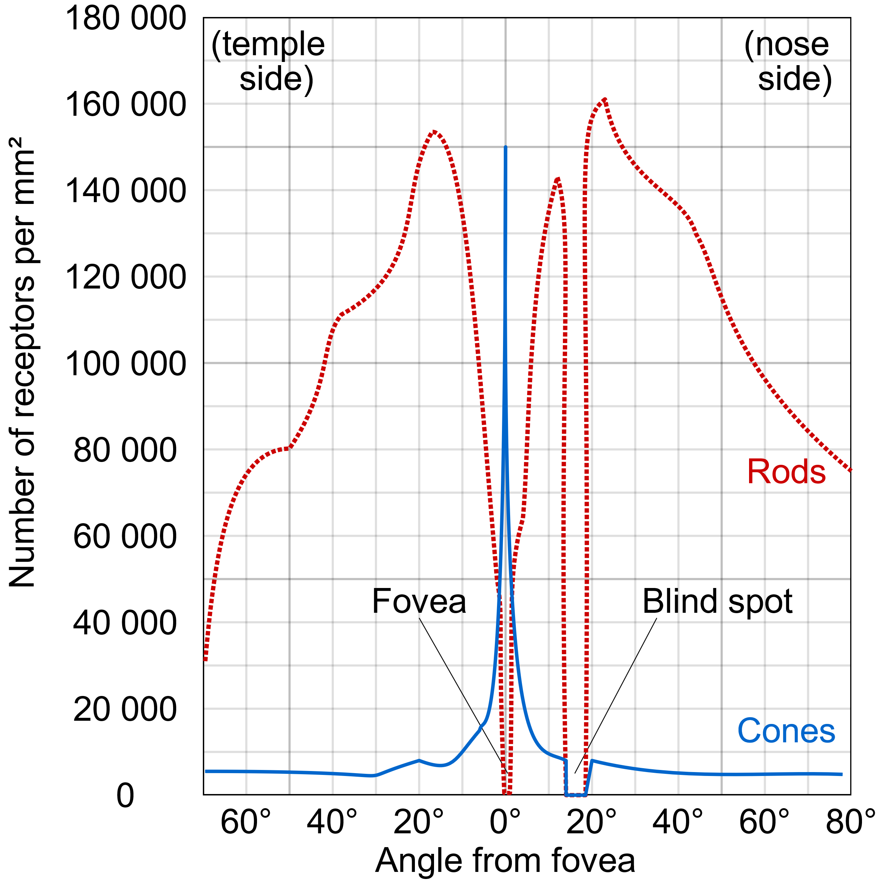
The Retina: Macula and Fovea
Macula
High-acuity
Color-rich central vision
Used for reading, face recognition, and fine inspection
Fovea
Absolute peak spatial resolution and color discrimination under bright light
By Cmglee - Own work, CC BY-SA 3.0, https://commons.wikimedia.org/w/index.php?curid=29924570

Slide 7
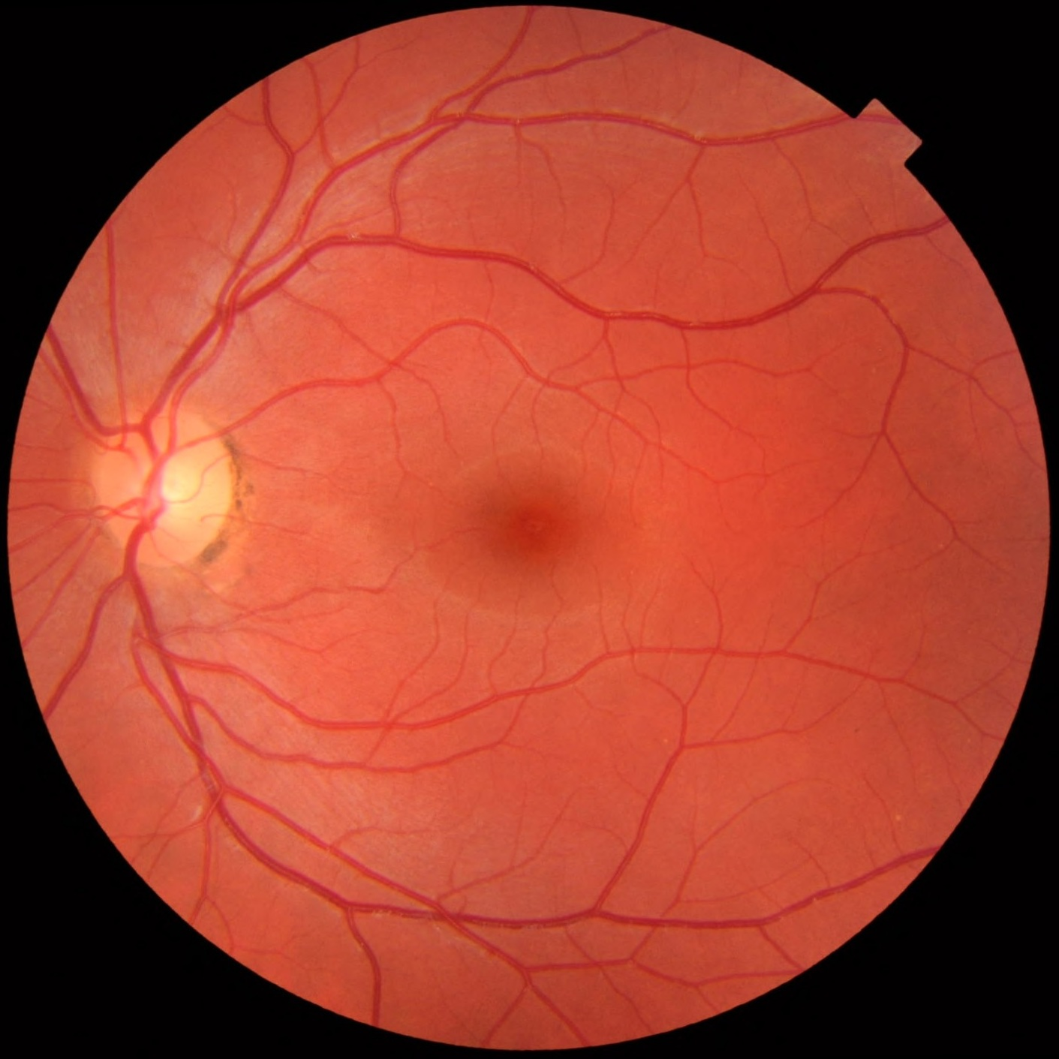
The Retina: Macula, Fovea and Optic Nerve
Blind Spot
Small area in the visual field where there is no vision.
Caused by the absence of light-sensitive cells (photoreceptors) at the point where the optic nerve exits the eye.
By Mikael Häggström.When using this image in external works, it may be cited as:Häggström, Mikael (2014). "Medical gallery of Mikael Häggström 2014". WikiJournal of Medicine 1 (2). DOI:10.15347/wjm/2014.008. ISSN 2002-4436. Public Domain.orBy Mikael Häggström, used with permission. - Own work, CC0, https://commons.wikimedia.org/w/index.php?curid=18776089
Notes:
Fundus photograph of the retina including the macula (dark spot in the middle) and optic nerve (light circle to the left)

Slide 8
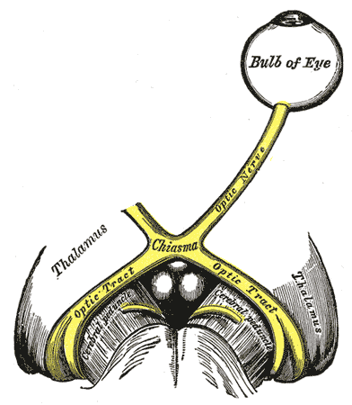
First Visual Cortex (V1)
Path: Eye → LGN (relay) → V1 (first visual cortex)
V1
Keeps a neat map of the scene
Detects edges at different angles and sizes
Passes this info to V2 for more complex patterns.
In the occipital lobe
By Henry Vandyke Carter - Henry Gray (1918) Anatomy of the Human Body (See "Book" section below)Bartleby.com: Gray's Anatomy, Plate 773, Public Domain, https://commons.wikimedia.org/w/index.php?curid=541621
Notes:
V1 neurons act like oriented edge detectors at different scales—very much like applying banks of filters. The layout preserves the image’s geometry (retinotopy), enabling the brain to build contours and shapes.

Slide 9
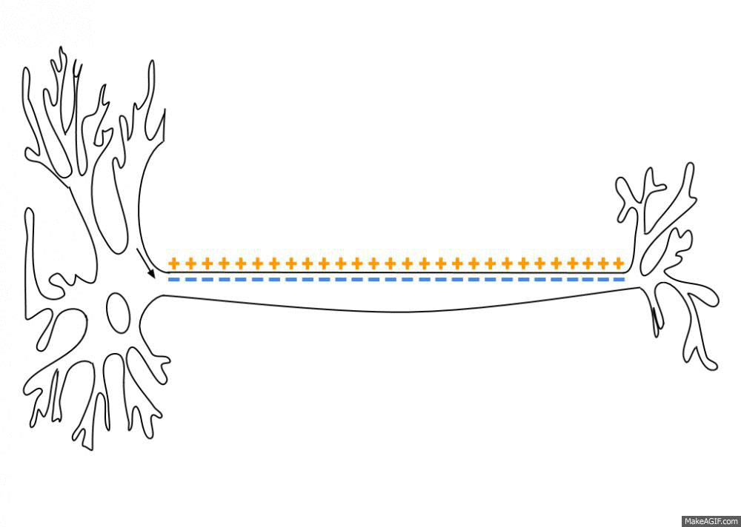
Visual Neurons
Fire action potentials when visual stimuli appear in their receptive field
Certain neurons respond best to specific stimuli (neuronal tuning)
In the earlier visual areas, neurons have simpler tuning.
By Laurentaylorj - Own work, CC BY-SA 3.0, https://commons.wikimedia.org/w/index.php?curid=26311114
Notes:
V1 neurons act like oriented edge detectors at different scales—very much like applying banks of filters. The layout preserves the image’s geometry (retinotopy), enabling the brain to build contours and shapes.

Slide 10
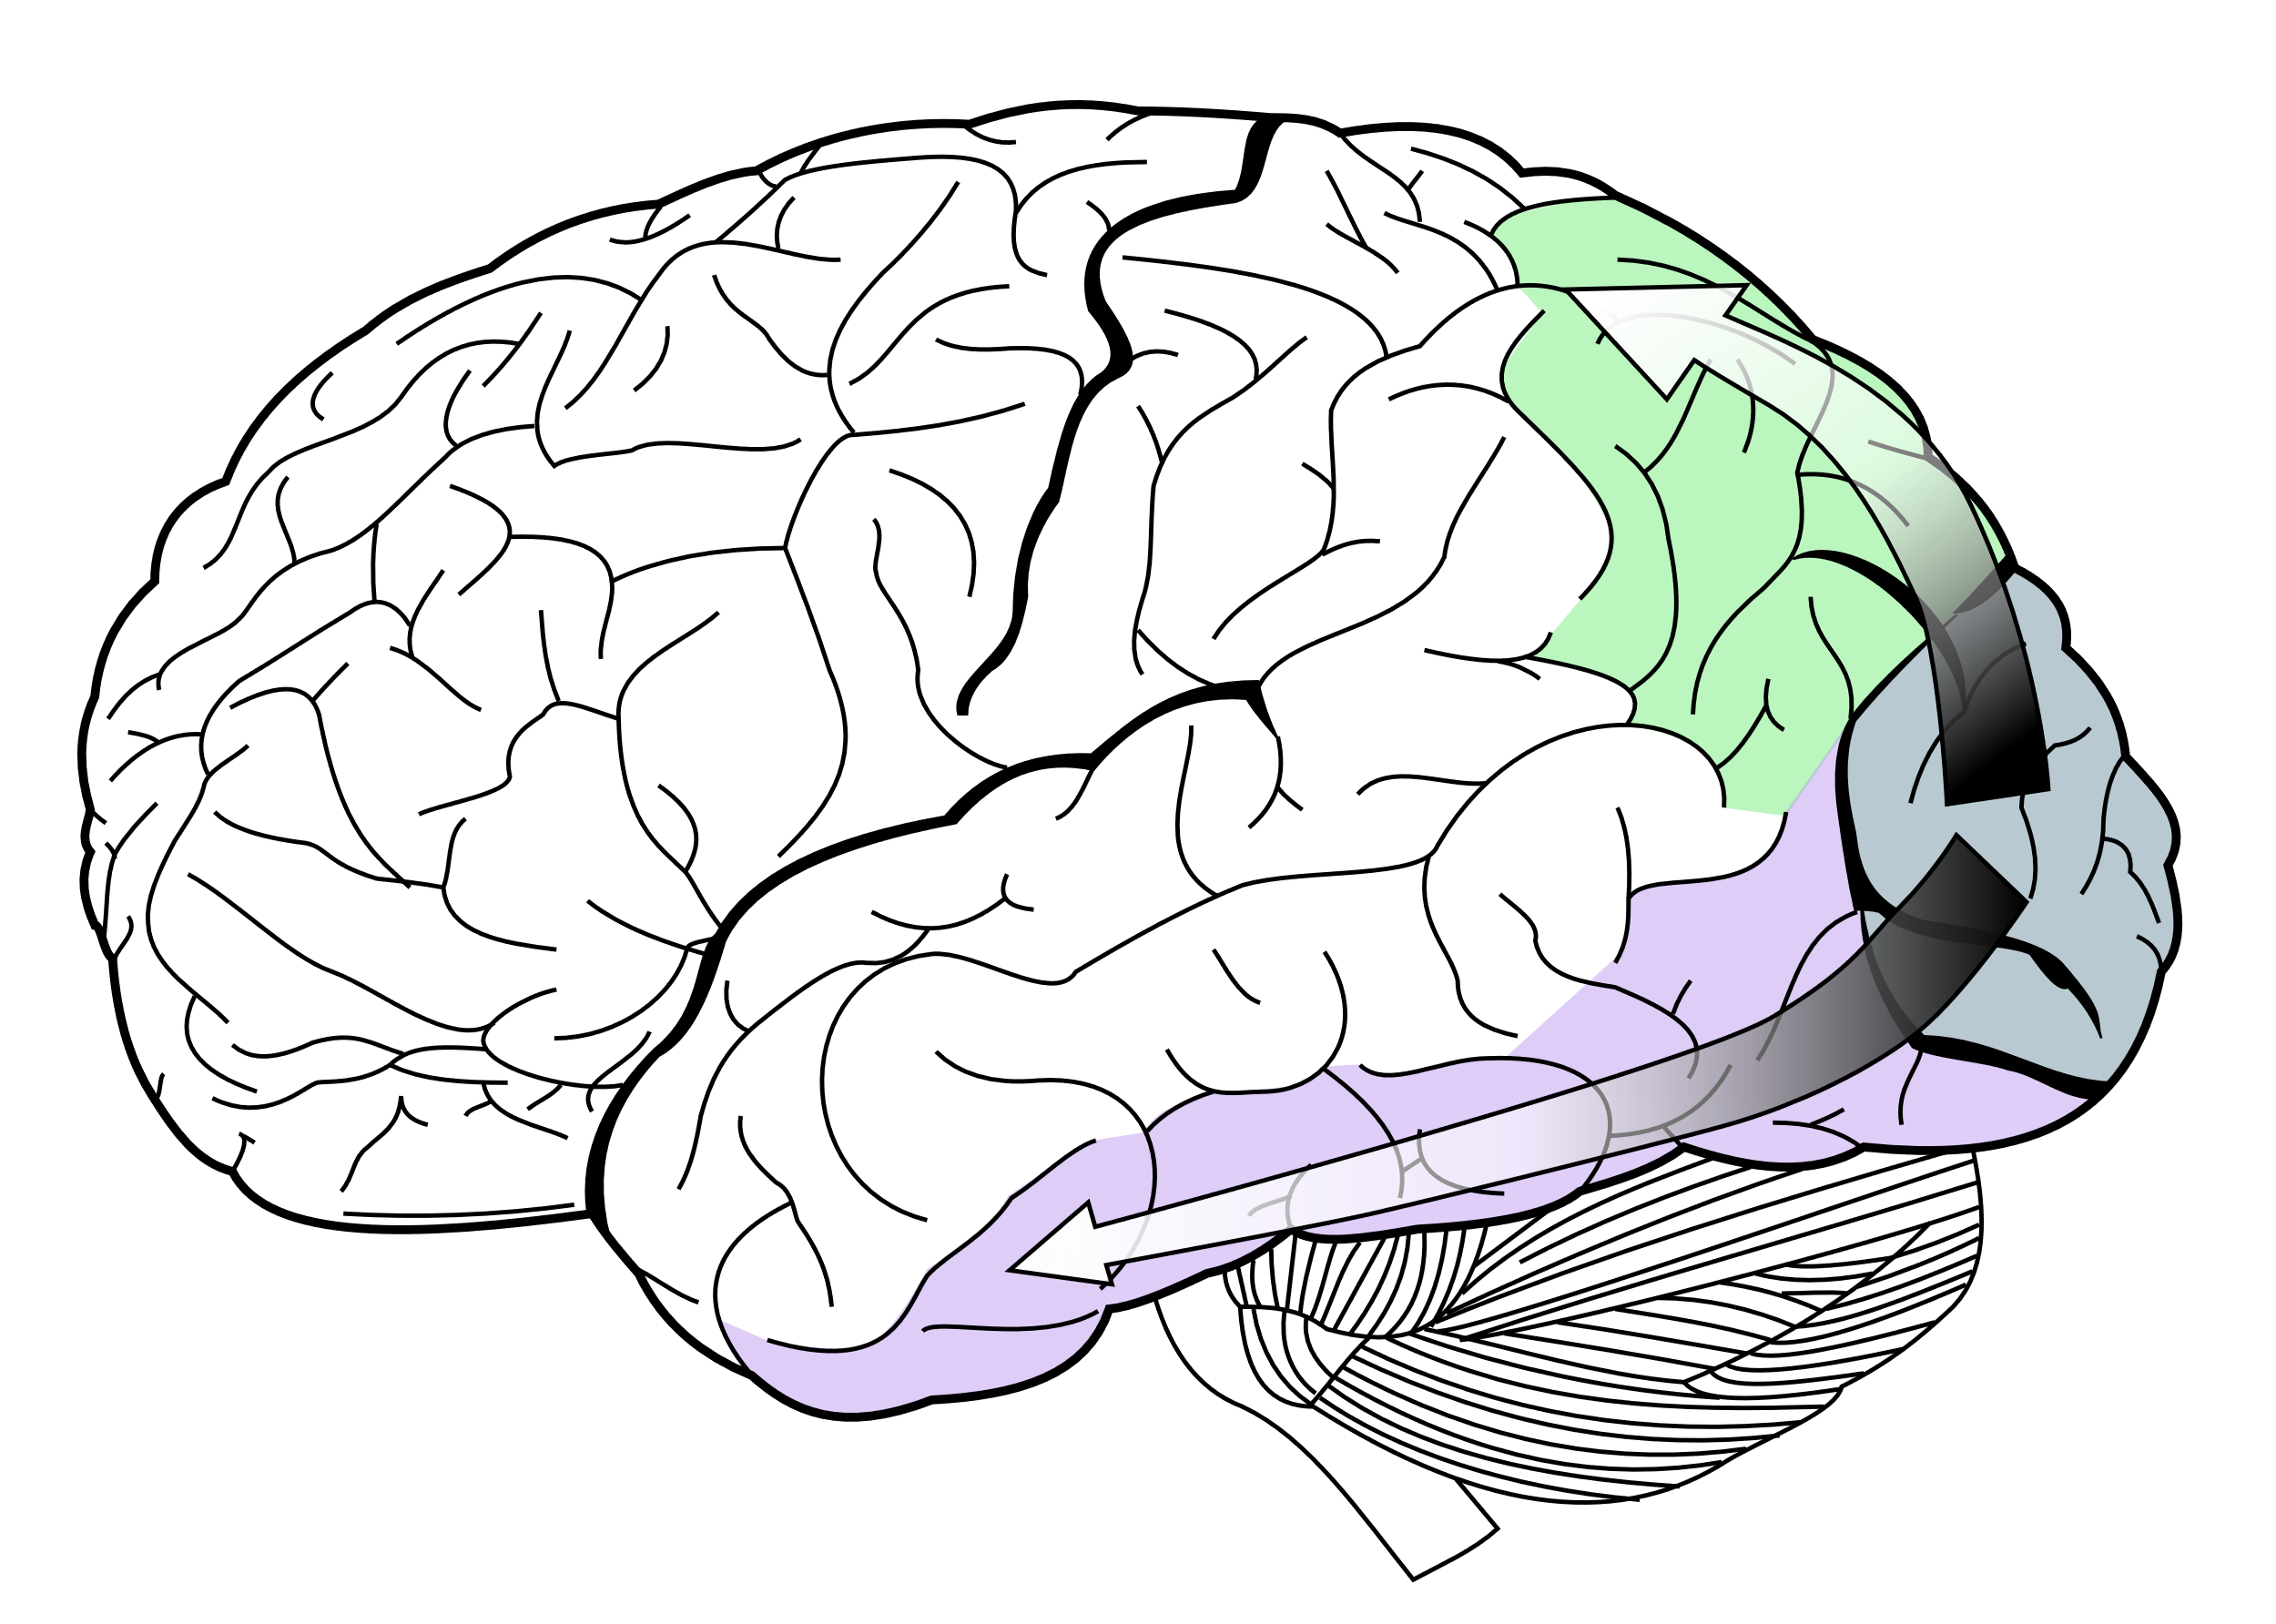
The “What” Pathway
Ventral Stream
Begins with V1, goes through visual area V2, then through visual area V4, and to the inferior temporal cortex
Associated with form recognition and object representation
Also associated with storage of long-term memory
Ventral Stream
By Selket - I (Selket) made this from File:Gray728.svg, CC BY-SA 3.0, https://commons.wikimedia.org/w/index.php?curid=1679336

Slide 11
The “Where/How” Pathway
Dorsal Stream
Begins with V1, goes through visual area V2, then to the dorsomedial area and middle temporal area (MT/V5) and to posterior parietal cortex
Associated with motion, representation of object locations, and control of the eyes and arms, especially when visual information is used to guide reaching.
Dorsal Stream
By Selket - I (Selket) made this from File:Gray728.svg, CC BY-SA 3.0, https://commons.wikimedia.org/w/index.php?curid=1679336

Slide 12
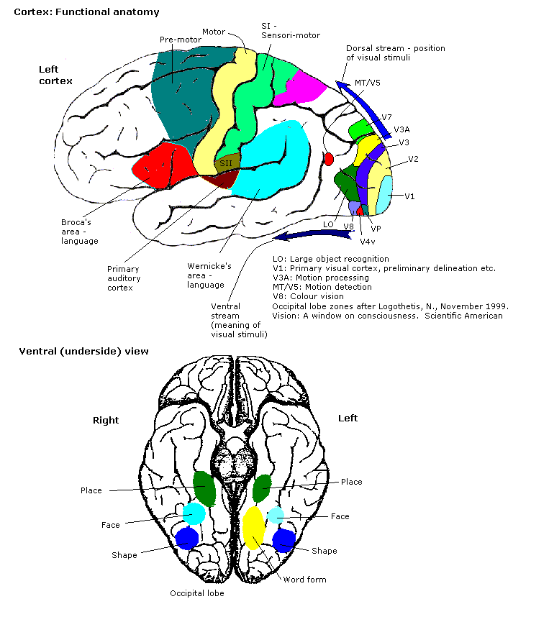
How the Brain Builds Recognition
The brain builds a picture in layers:
Edges
Parts
Objects
Makes a quick first guess then refines based on data and expectations
Notes:
The brain builds a picture in layers. It makes a quick first guess, then uses attention and what you expect to see to refine it. Because info moves both up and down, context can change what you perceive.”

Slide 13
Perceptual Magic: Constancy, Depth, Motion, Attention
Stable colors: Your brain corrects for lighting (color/brightness constancy).
Depth from hints: Stereo (two eyes), parallax (move your head), perspective (lines converge), shading (light & shadow).
Motion pops: We notice change; the periphery is great at detecting movement.
Selective seeing: Fast eye jumps (saccades) + attention decide what gets processed → change blindness happens.
Notes:
The brain maintains stable perception across lighting and viewpoint by making assumptions. That’s powerful—and exploitable. Depth is inferred from multiple cues; motion and attention decide what gets processed at high fidelity. We don’t passively record; we actively model the world.

Slide 14
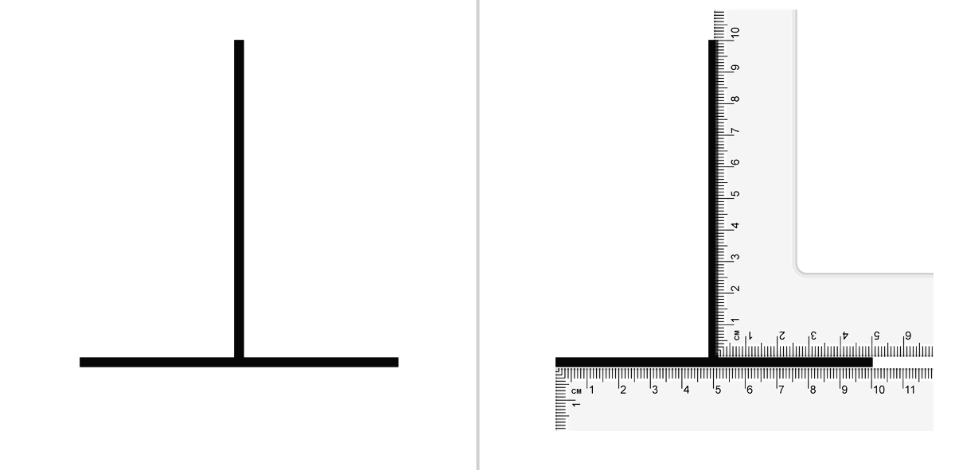
Optical illusions
Illusions show vision is inference, not a camera
By S-kay - Own work, Public Domain, https://commons.wikimedia.org/w/index.php?curid=8845534
Notes:
Your brain guesses the world from limited, noisy input. Illusions prove we do interpretation, not raw recording. We’ll tour the human pipeline from optics to perception—and set up parallels to computer vision later.

Slide 15
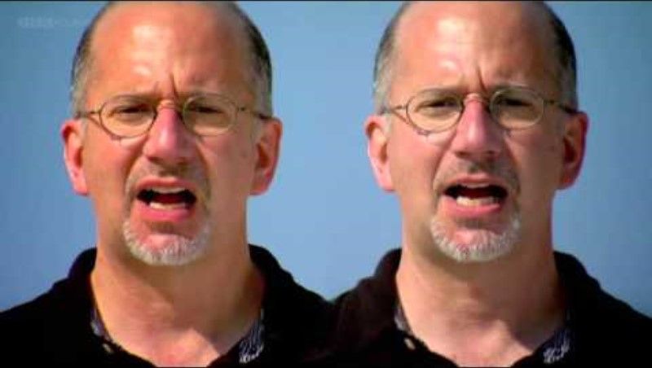
The McGurk Effect

Slide 16

Sensory Hallucination

Slide 17
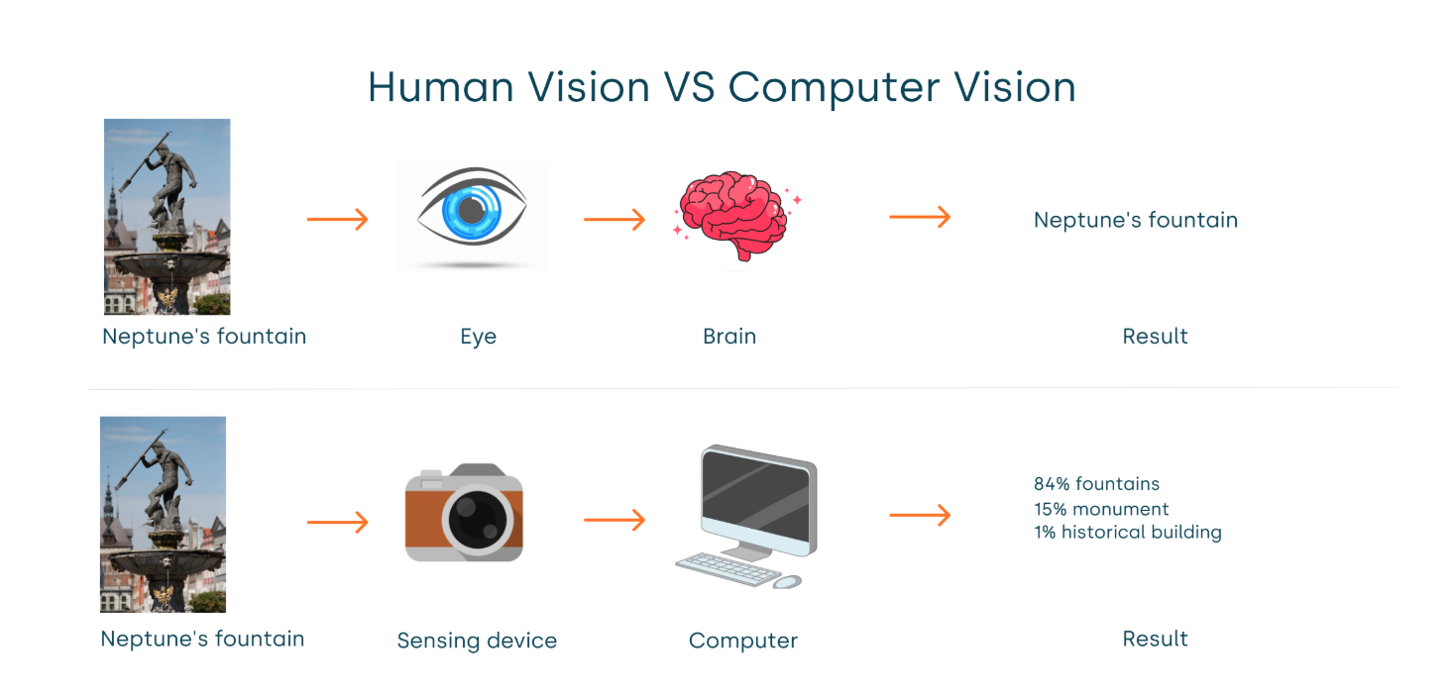
Human vs. Computer Vision

Slide 18
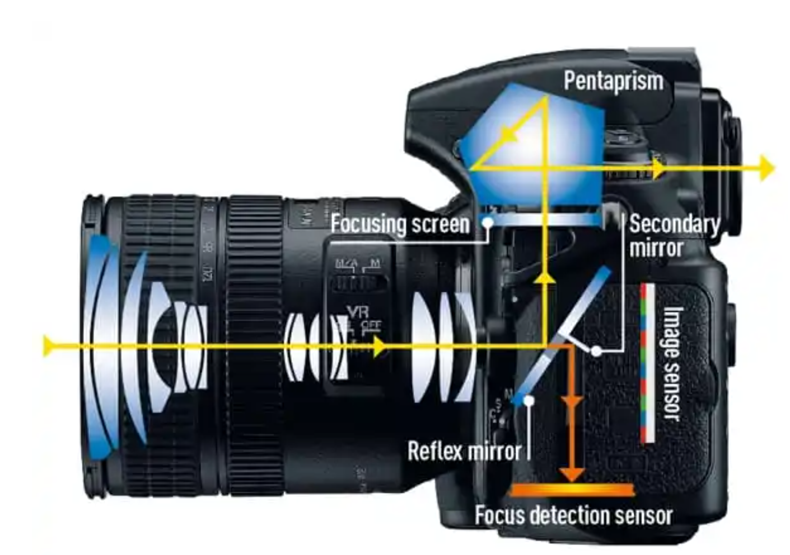
How Cameras Capture an Image
Lens focuses light and aperture controls how much light enters.
Similar to human lens, cornea and iris
Notes:
Photons arrive at a pixel cell’s photodiode.
The photodiode converts photons → electrons (charge) and accumulates them during the exposure (the “bucket” idea).
After exposure, electronics measure the accumulated charge (like a light meter reading), convert it to a voltage, then an ADC turns it into a number (the pixel value).

Slide 19
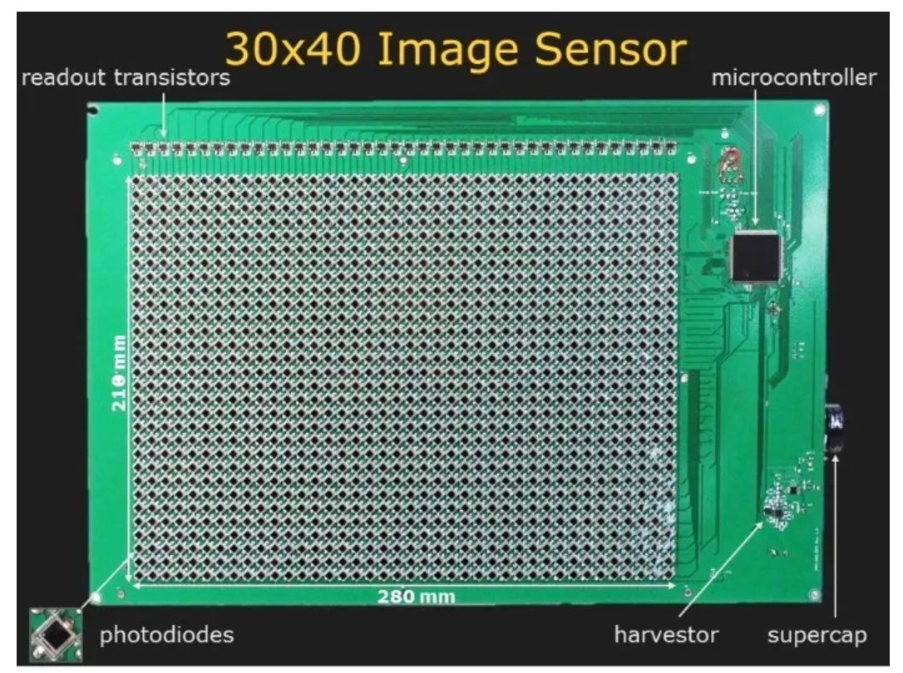
How Cameras Capture an Image
Photons of light arrive at each of the camera’s millions of pixel cell photodiodes
The photodiode turns the light into electrical charge and accumulates them during exposure
The camera measures the charge and stores the result as a number called the pixel value
Notes:
Photons arrive at a pixel cell’s photodiode.
The photodiode converts photons → electrons (charge) and accumulates them during the exposure (the “bucket” idea).
After exposure, electronics measure the accumulated charge (like a light meter reading), convert it to a voltage, then an ADC turns it into a number (the pixel value).

Slide 20
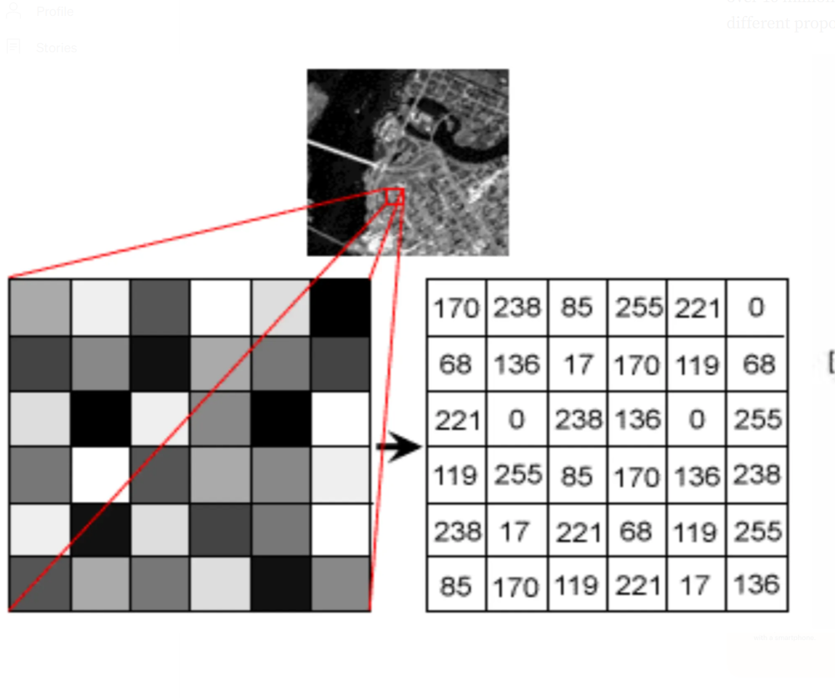
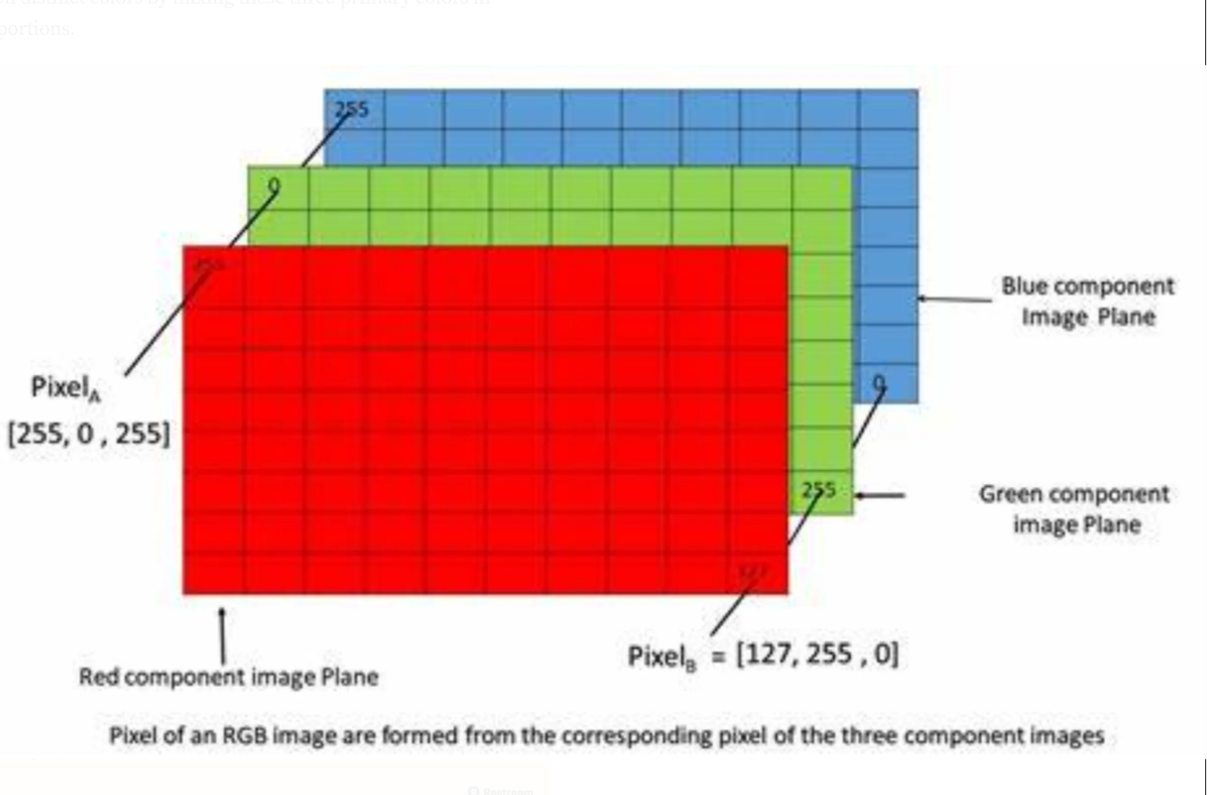
Digital Images
A digital image is a grid of tiny squares called pixels.
Example: 1920 × 1080 ≈ 2.07 million pixels (≈2 MP).
Each pixel stores numbers.
Grayscale: 1 number per pixel (0 = black … 255 = white).
Color (RGB): 3 numbers per pixel (R, G, B).

Slide 21
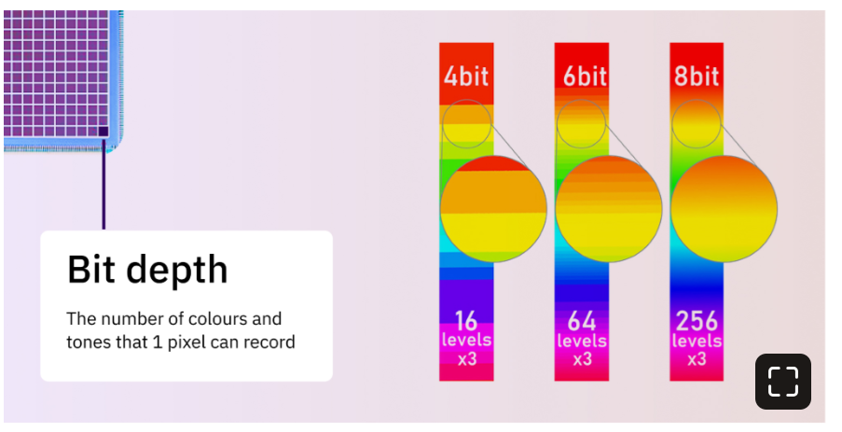
Digital Images
More pixels ≈ more detail (until the lens, focus, or noise becomes the limit).

Slide 22
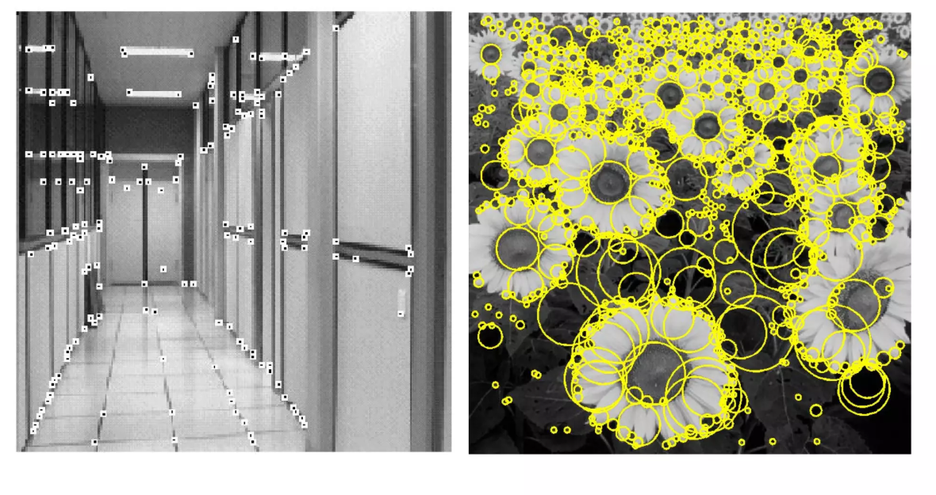
Pixels to Patterns
Looking for similarities and differences between neighboring pixels
Edges: big differences between neighbors
Corners: Edges meeting
Blobs: Roundish contrast
Scale matters:
Small patches find fine detail
Bigger patches find coarse structure

Slide 23
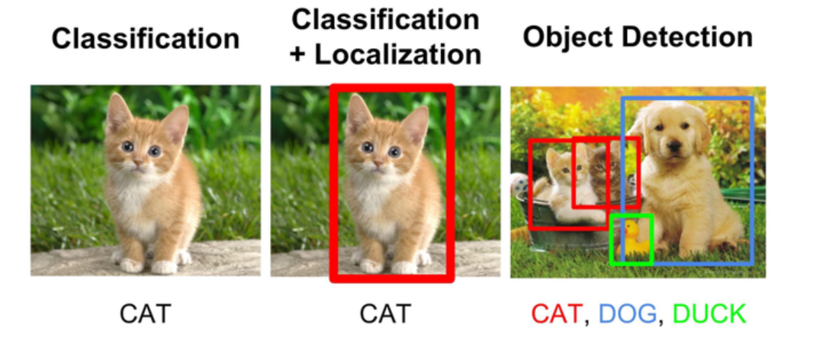
Computer Vision Applications
.
Image classification: one label for the whole image
Object detection: boxes + labels around each object
Segmentation: which pixels belong to the object
Motion/change detection: what moved between frames
Tracking: follow the same object over time

Slide 24
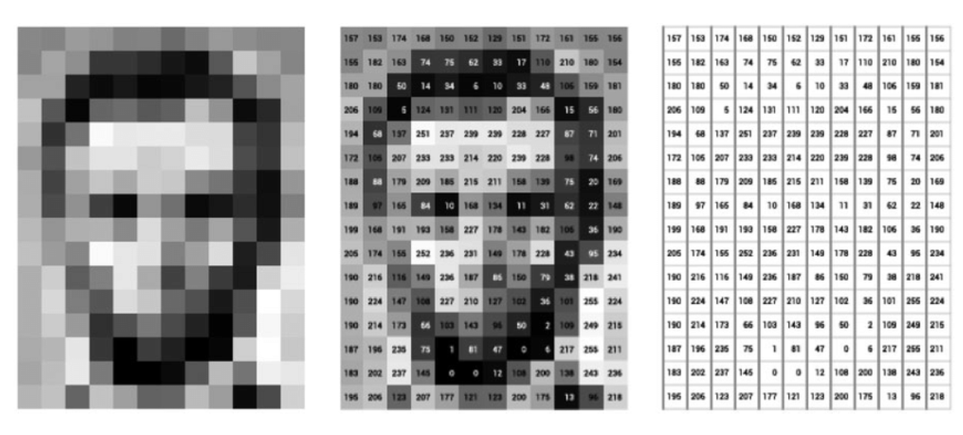
Next time…
Image preprocessing

